Slide 1

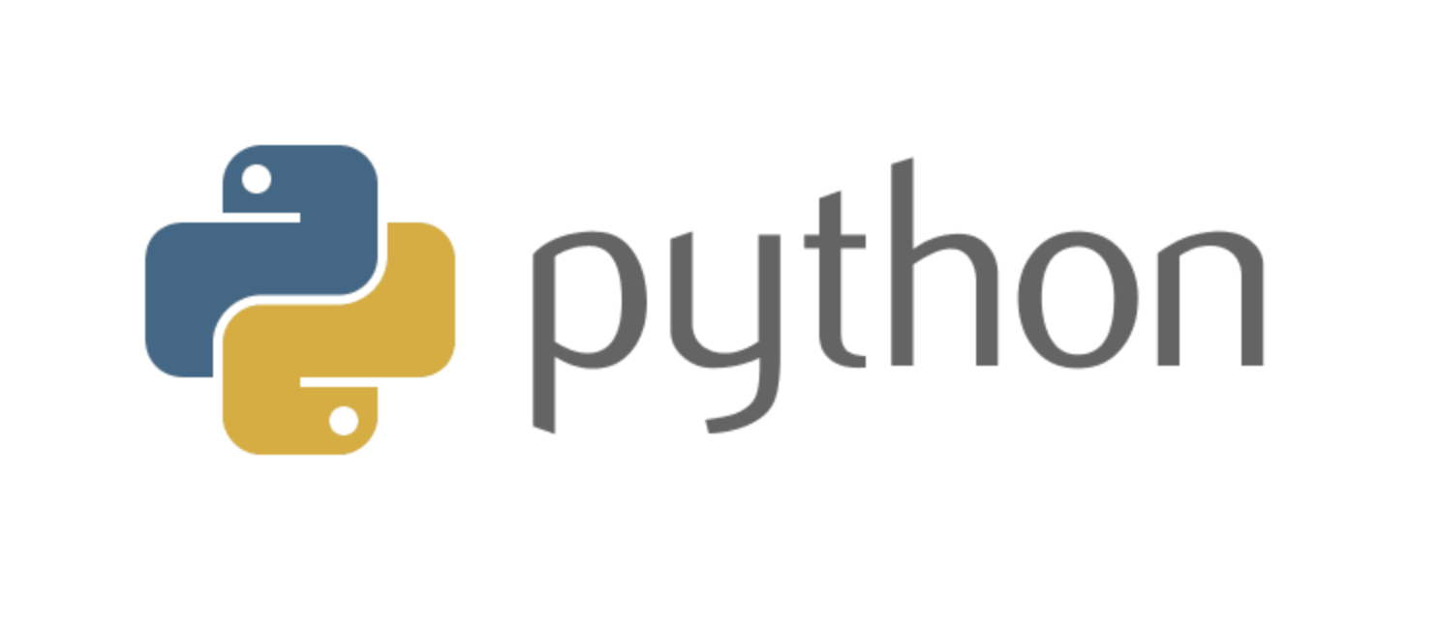

Week 1, Lecture 2: Conditionals, functions, loops and more

Slide 2
Admin stuff and reminders:
Don’t forget this week’s discussion topics!
https://login.codingdojo.com/d/309/119/1190
https://login.codingdojo.com/d/309/119/1191
Due Sunday night at 11:59 PM Pacific! Don’t fall behind!!
Answer the Discord poll regarding a bonus office hour with Mel!
Fill out survey gauging interest in collaborative/group activities: https://docs.google.com/forms/d/e/1FAIpQLSfeMacwVl5cw3rNjB-UPGcFuKT5N7sXvlfC3_-2GJvohw_PxA/viewform?usp=sf_link
This week’s core assignments:
For Loop Basic I
Functions Intermediate I
Always read the material before the lecture!!
Plenty of 1-on-1 slots available! But utilize 20-minute rule first!

Slide 3
Lecture agenda:
Conditionals
Loops
Functions and methods
Loop through a list of dictionaries (if time permits) - definitely review this in a few weeks!

Slide 4
How are you feeling today?
1 = Not good
10 = Very good

Slide 5
Conditional statements

Slide 6
Question 1:
What is the correct syntax for testing if a variable called x is more than 0 and less than 10?
x = 5
???? # Replace the "????" with your answer
print("x is more than 0 and less than 10")
Multiple-choice:
if (x > 0 && x < 10)
if x > 0 and x < 10:
if x > 0 && x < 10
if x > 0 and x < 10

Slide 7
Question 1:
What is the correct syntax for testing if a variable called x is more than 0 and less than 10?
x = 5
if x > 0 and x < 10: # Use a colon : at the end!
print("x is more than 0 and less than 10")
Multiple-choice:
if (x > 0 && x < 10)
if x > 0 and x < 10: # Use "and", NOT &&
if x > 0 && x < 10
if x > 0 and x < 10

Slide 8
Conditional statements
Why would conditional (if) statements be handy?
Because you might only want to perform certain actions when a condition - or a set of conditions - is met. For example in real life, you can only prepare a new dish from scratch when you have all the ingredients. So think of it like this:
if ingredients are available:
Cook item
else:
Gather ingredients

Slide 9
Demo of conditional statements

Slide 10
Conditional statements
General structure
if condition_is_true:
# write your code here
elif second_condition_is_true:
# Write code here
else:
# Write code here
You can have as many “elif” clauses as you wish - all optional
The “else” clause is optional also
You can combine conditions using “and”/”or”, which are the Python equivalents of “&&”/”||”
REMEMBER: The first set of conditions that’s satisfied is what will execute - everything else in that block will be ignored, EVEN IF that another set of conditions is satisfied afterwards.

Slide 11
Other Python syntax notes
Use the “pass” keyword when you know you need to implement some programming logic, but don’t know exactly what to type in yet:
if x > 10:
pass # Do not know what to type, but we know we need the if block
Pay attention to tabs and spaces!
if x > 10:
print("Inside if block")
print("NOT in if block")
Watch capitalization for True/False (vs. true/false in JS) and None

Slide 12
Loops

Slide 13
Loops
Why would we want to use a loop in code?
We use loops to repeat a block of code a bunch of times. Think of it this way: one might fold a bunch of pants after washing them, one at a time.
Here is some “pseudocode” (looks like, but isn’t, real code):
for each pair of pants in a pile of pants:
fold the current pair of pants

Slide 14
Loops
Loops are used to run through the same block of code a bunch of times
Several different types of loops:
for loop - when we know where to start/end and how often we’ll run the code
while loop - keep running the code an indefinite (unknown) number of times until some condition fails

Slide 15
Question 2
Write a loop that prints whether each number in a list of integers called x is even or odd. For example, given the list [3, 4, 7], the output should be:
3 is odd
4 is even
7 is odd
HINT: If you want a good starting point, think about how to print each value in the list first before checking whether it’s even or odd.

Slide 16
Question 2
Write a loop that prints whether each number in a list of integers called x is even or odd. For example, given the list [3, 4, 7], the output should be:
3 is odd
4 is even
7 is odd
One answer (other variations are acceptable):
x = [3, 4, 7] # Define the list
for k in range(len(x)): # k is a variable representing the index
if x[k] % 2 == 0: # % is the mod operator
# If you didn’t use an f-string, you must use the str() function
print(f"{x[k]} is even")
else:
print(f"{x[k]} is odd")

Slide 17
Demonstration of loops

Slide 18
Loops
Two ways to loop through a list:
for k in range(len(some_list)): # k is the index: 0, 1, 2, ...
print(some_list[k])
for val in some_list: # val is the actual value itself
print(val) # Notice there’s no index here - the value itself is being used
Looping through a dictionary:
# curr_key is the current key we’re examining; my_dictionary is a variable
for curr_key in my_dictionary.keys():
print(my_dictionary[curr_key])
for key, val in my_dictionary.items():
print(key) # Print the current key
print(value) # Print the value linked to the current key

Slide 19
Functions and methods

Slide 20
Functions
Why would we use a function in code in the first place?
Functions are useful for running the same block of code on demand - in other words, when you call on them. Think of it like making a new recipe from scratch.
Not repeating blocks of code - would you like to have the same 1000 lines used the exact same way dozens of times? This is the idea of “Don’t Repeat Yourself”.
Flexibility in terms of input - let’s take a real-life example: you need to make 120 cookies. Another time you might need to make only 24. Think of functions like this:
make_cookies(120)
make_cookies(24) # Same code internally, but different input

Slide 21
Question 3
Write a Python function called sum_list that takes in a list of numbers as input and returns the sum of the entries as output. If the list is empty, return 0.

Slide 22
Question 3
Write a Python function called sum_list that takes in a list of numbers as input and returns the sum of the entries as output. If the list is empty, return 0.
One way to do (other variations are acceptable):
def sum_list(some_list):
if len(some_list) == 0: # Empty list
return 0
else:
total = 0 # Start off with 0
for i in range(len(some_list)): # Loop through list
total += some_list[i] # Add current item
return total # Return cumulative sum

Slide 23
Demo of functions

Slide 24
Functions and methods
Functions and methods are defined the same way in Python:
def function_name(): # Inputs go inside the parentheses - these are parameters
# Put your code here, or type “pass” as a placeholder
A function is standalone, while a method goes inside a class (more on this Monday).
Usually functions/methods return values so that you can use them later:
my_list = [3, 8, 15]
this_sum = sum_list(my_list) # Result of function is stored in this_sum - so 26
print(this_sum)
A function won’t be used until it’s called!
If you don’t return a value from a function, you’ll get None when printing the result!

Slide 25
Loop through a list of dictionaries

Slide 26
Lists of dictionaries
Why would we deal with this? In a real-life setting, you will often deal with combinations of data types, like a list of dictionaries, or a dictionary with lists, or something even more complicated than that.
Data are often exchanged between machines through a .JSON (JavaScript Object Notation) format, which is basically a dictionary, and in that dictionary could be values, lists, more dictionaries, etc.
When you interact with your database in a few weeks, the data will come back as a list of dictionaries! Each row is a dictionary, and the list’s length is equal to the number of rows you get back! (It’ll make more sense in a few weeks!)
Here are some examples from Melissa, another instructor:
https://my-looney-tunes-api.herokuapp.com/api/characters
https://dojo.navyladyveteran.com/

Slide 27
Question 4
Question 4: Given the following:
x = [
{"id": 1, "name": "Melissa"},
{"id": 3, "name": "Adrian"},
{"id": 6, "name": "John"},
]
Print everybody in the following pattern:
Person #1 is Melissa
Person #3 is Adrian
Person #6 is John
This is a bit of a taste of the type of data you’ll be handling in a few weeks!

Slide 28
Question 4
Question 4: Given the following:
x = [
{"id": 1, "name": "Melissa"},
{"id": 3, "name": "Adrian"},
{"id": 6, "name": "John"},
]
Print everybody in the following pattern:
Person #1 is Melissa
Person #3 is Adrian
Person #6 is John
ANSWER (other variations are acceptable):
for curr_dictionary in x:
# WARNING: Don't mix quotation marks up - you must use two different types below
print(f'Person #{curr_dictionary["id"]} is {curr_dictionary["name"]}')
curr_dictionary is the dictionary we’re examining, one at a time
Notice the f string above!
Observe how we’re grabbing a value linked to a key - and the dictionary we’re referring to

